Slide 1
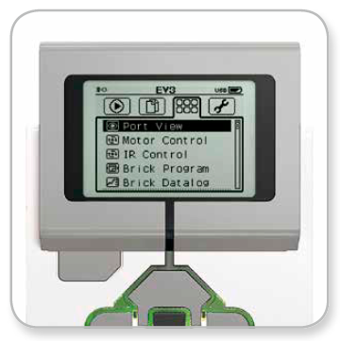
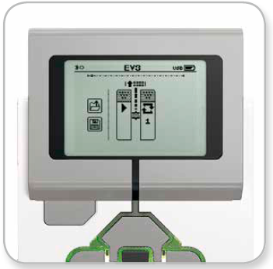
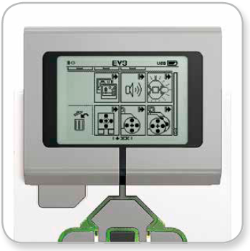
EV3 On Brick Programming
Blocks get inserted at vertical line
Turn Brick on
Select Right button twice
  This is the Brick Apps screen
Select Brick Program App
  This leads to the Start screen
Select Up button to choose block
  This leads to the Block Palette
Select Up button again to see
more of the Block Palette

Slide 2
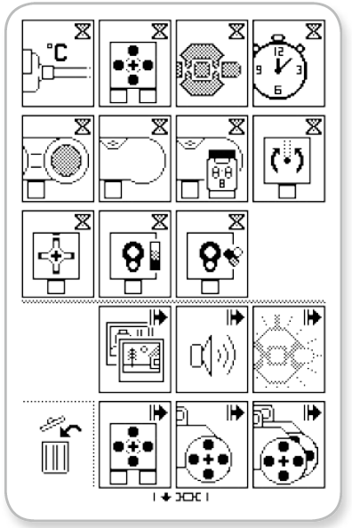
EV3 On Brick Programming
X
This is the full Brick Palette
(This cannot be
seen on the screen all at once)
X
X
There are two types of commands:
  Wait for Input (Hourglass Blocks)
    Robot “Sensing its Environment”
  Take Output Action (Arrow Blocks)
    Evidence of Robot
    “Following Instructions”
Trash Can removes current block
The EV3 Core Set does not have all
these sensors

Slide 3
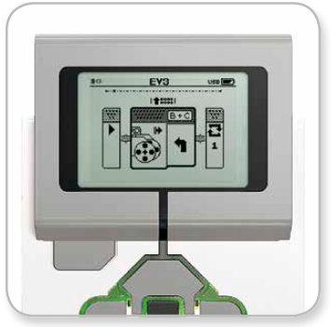
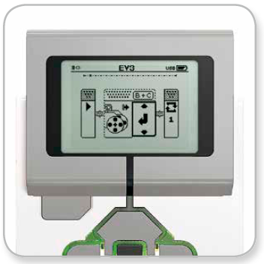
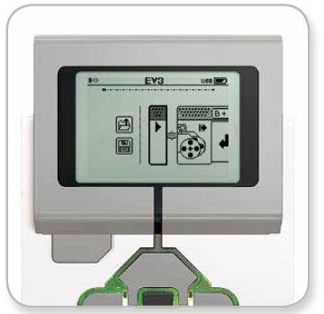
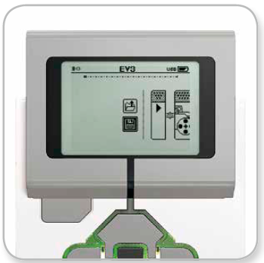
EV3 On Brick Programming
Navigate palette with Up, Down,
Left, Right buttons
Select desired block with Center
button
Select Center button again to modify
one parameter of this block
Use Up/Down buttons to change value
Select Back button to return to Beginning
  Use Center button to Run program
Select Save button to Name and Save
program

